Slide 1


Headway Deterioration on PVTA UMass Routes
Aruni Roychowdhury
Rajarshi Roychowdhury

Slide 2
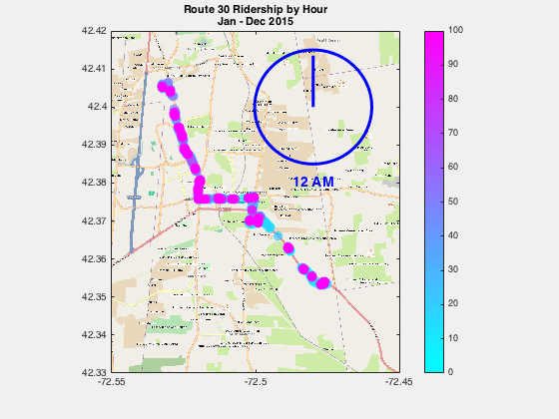
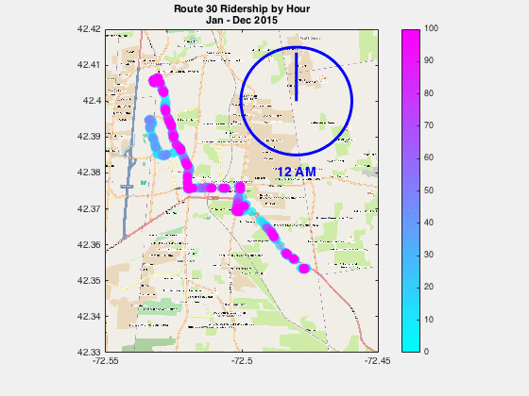
Ridership of PVTA Route 30, by hour of the day

Slide 3
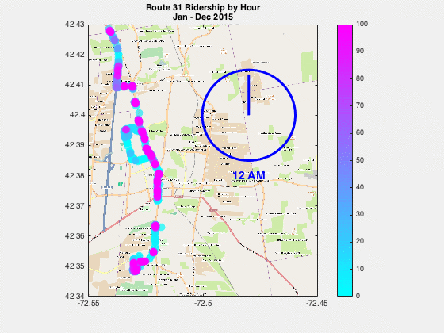
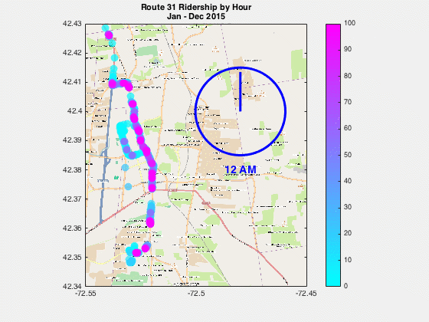
Ridership of PVTA Route 31, by hour of the day

Slide 4
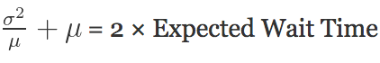
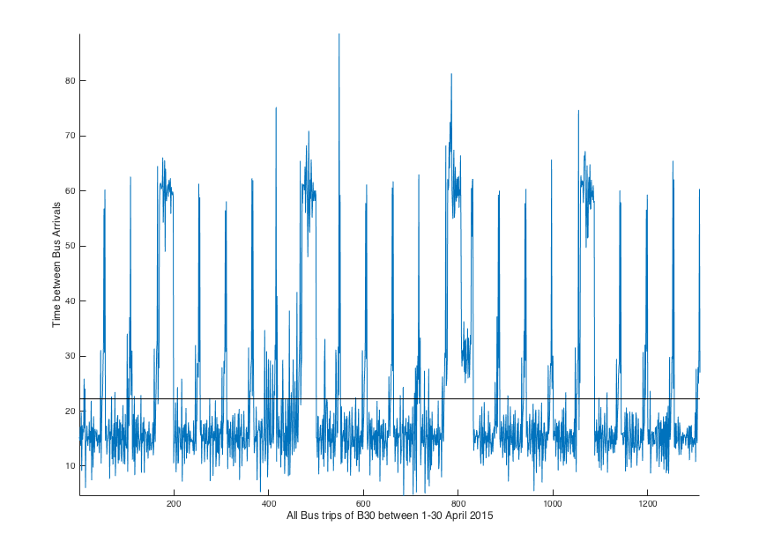
Expected Wait Time and Variance in Headway
Headway variance is the variance of intervals between buses arriving at a station.
Min var(H) = min E(W)

Slide 5
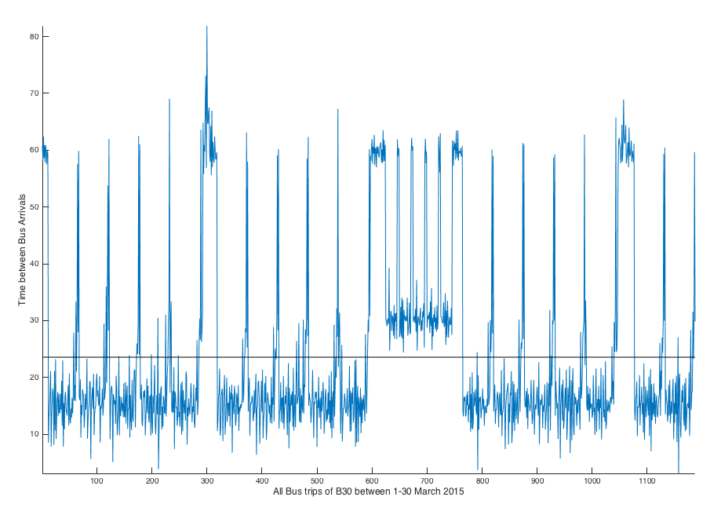
Expected Wait Time and Variance in Headway
Headway Variance is the variance of intervals between buses arriving at a station.
Min var(H) = min E(W)

Slide 6
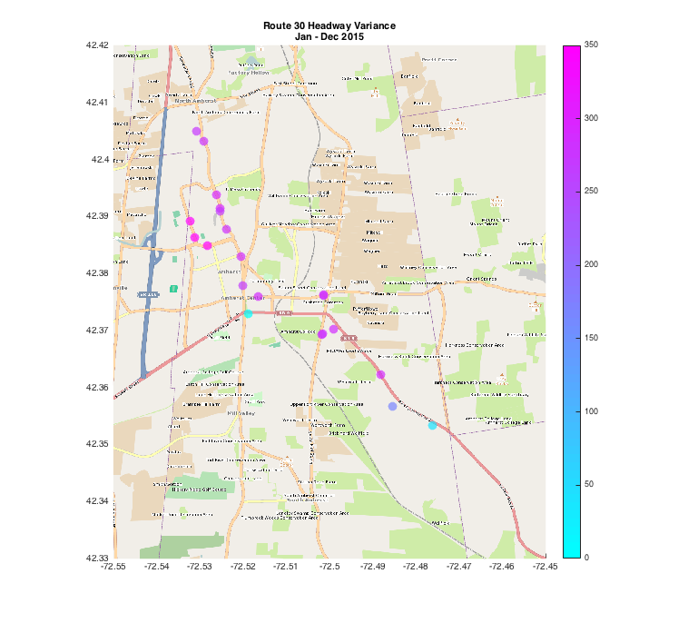
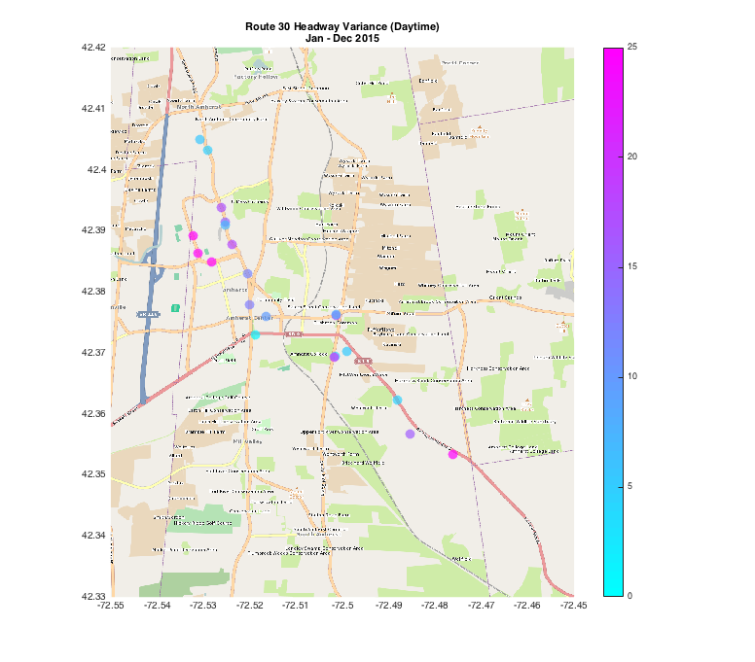

Slide 7
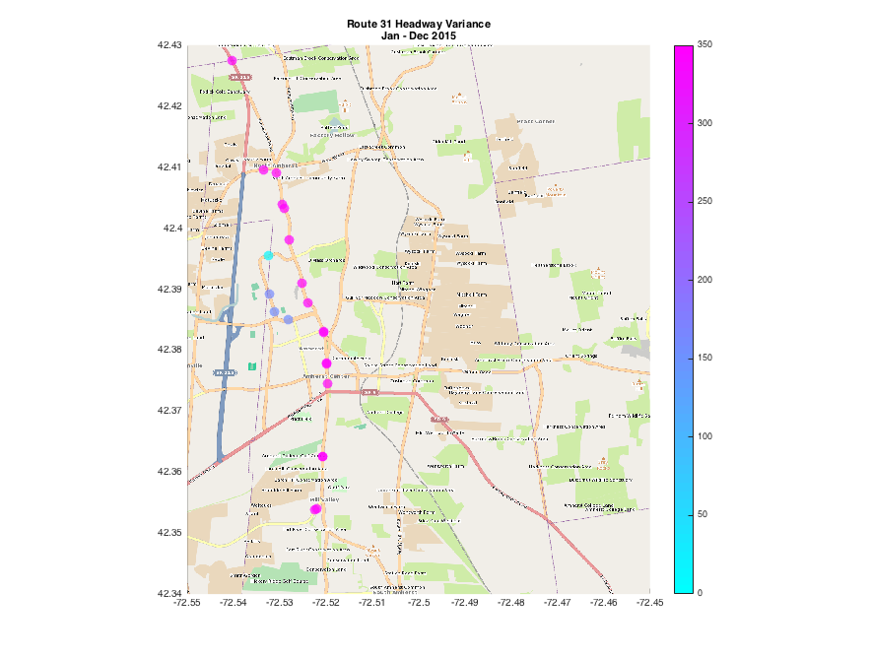
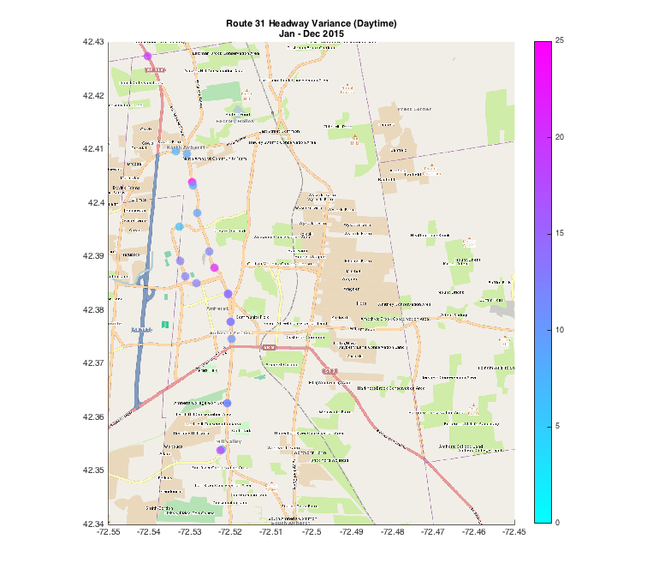

Slide 8
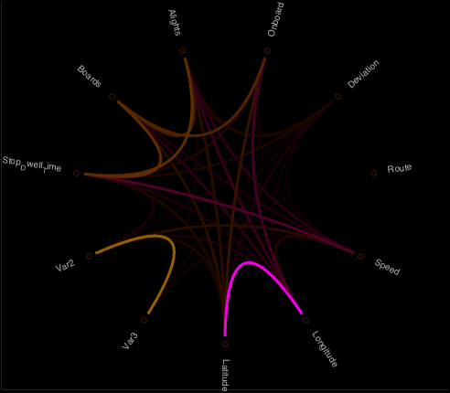
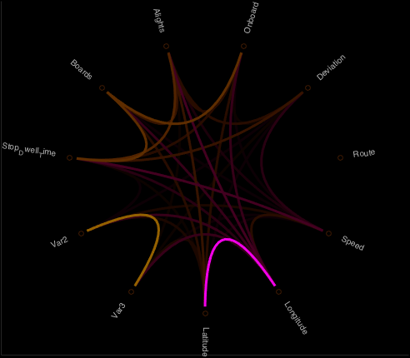
Correlation of Headway Variance with possible predictors
Summer
Winter
Var(H) = 126.4064
Var(H) = 153.2631
Var2 : Headway Variance over a Particular Route
Var3 : Headway Variance during daytime for same Route

